Slide 1
Multimedia Computing
By
Minhaz Uddin Ahmed, PhD
Department of Computer Engineering
Inha University in Tashkent.
Email: minhaz.ahmed@gmail.com

Slide 2
Content
Background
Patterns and pattern classes
Pattern classification by prototype matching
Template matching
Statistical classifier
additional details

Slide 3
Pattern classification
A pattern is an arrangement of descriptors,
The name feature is used often in the pattern recognition literature to denote a descriptor.
A pattern class is a family of patterns that share some common properties

Slide 4
An Example
“Sorting incoming Fish on a conveyor according to species using optical sensing”
Sea bass
Species
Salmon

Slide 5
Problem Analysis
  Set up a camera and take some sample images to extract features
    Length
    Lightness
    Width
    Number and shape of fins
    Position of the mouth, etc…
    This is the set of all suggested features to explore for use in our classifier!

Slide 6
Preprocessing
Use a segmentation operation to isolate fishes from one another and from the background
Information from a single fish is sent to a feature extractor whose purpose is to reduce the data by measuring certain features
The features are passed to a classifier

Slide 7
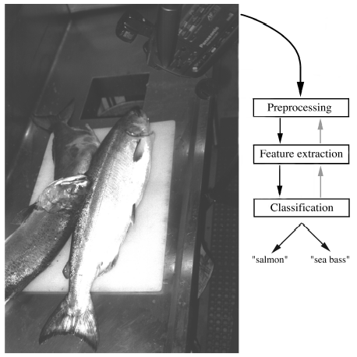
Preprocessing

Slide 8
Classification
  Select the length of the fish as a possible feature for discrimination

Slide 9
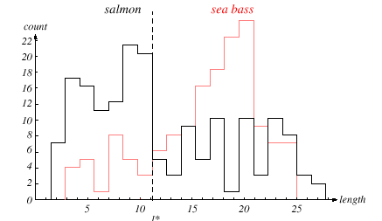
Feature identification
The length is a poor feature alone!
Select the lightness as a possible feature.

Slide 10
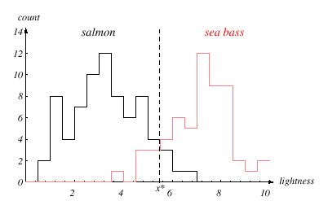
Feature identification

Slide 11
Threshold decision boundary and cost relationship
  Move our decision boundary toward smaller values of lightness in order to minimize the cost (reduce the number of sea bass that are classified salmon!)
  Task of decision theory

Slide 12
Adopt the lightness and add the width of the fish
Fish x^{T} = [x₁, x₂]
Lightness
Width

Slide 13
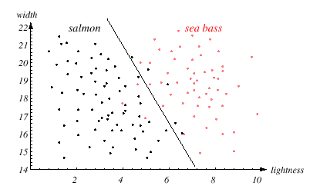
Threshold decision boundary and cost relationship

Slide 14
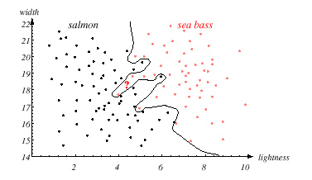
Best decision boundary
We might add other features that are not correlated with the ones we already have. A precaution should be taken not to reduce the performance by adding such “noisy features”
Ideally, the best decision boundary should be the one which provides an optimal performance such as in the following figure:

Slide 15
Classify Input
However, our satisfaction is premature because the central aim of designing a classifier is to correctly classify novel input
Issue of generalization!

Slide 16
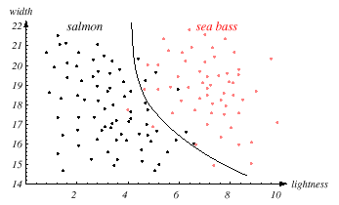
Classified Input

Slide 17
Pattern Recognition Systems
Sensing
  Use of a transducer (camera or microphone)
  PR system depends of the bandwidth, the resolution sensitivity distortion of the transducer
Segmentation and grouping
  Patterns should be well separated and should not overlap

Slide 18
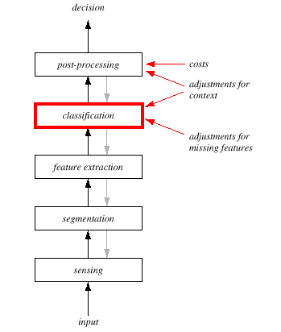
Pattern Recognition system

Slide 19
Feature extraction
  Discriminative features
  Invariant features with respect to translation, rotation and scale.
Classification
  Use a feature vector provided by a feature extractor to assign the object to a category
Post Processing
  Exploit context input dependent information other than from the target pattern itself to improve performance

Slide 20
The Design Cycle
Data collection
Feature Choice
Model Choice
Training
Evaluation
Computational Complexity

Slide 21
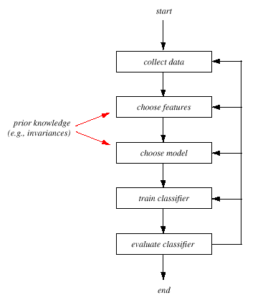
The Design Cycle

Slide 22
Data Collection
  How do we know when we have collected an adequately large and representative set of examples for training and testing the system?

Slide 23
Feature Choice
  Depends on the characteristics of the problem domain. Simple to extract, invariant to irrelevant transformation insensitive to noise.

Slide 24
Model Choice
  Unsatisfied with the performance of our fish classifier and want to jump to another class of model

Slide 25
Training
  Use data to determine the classifier. Many different procedures for training classifiers and choosing models

Slide 26
Evaluation
  Measure the error rate (or performance and switch from one set of features to another one

Slide 27
Computational Complexity
  What is the trade-off between computational ease and performance?
  How an algorithm scales as a function of the number of features, patterns or categories?

Slide 28
Learning and Adaptation
Supervised learning
  A teacher provides a category label or cost for each pattern in the training set
Unsupervised learning
  The system forms clusters or “natural groupings” of the input patterns

Slide 29
Statistical Pattern Recognition
The data is reduced to vectors of numbers and statistical techniques are used for the tasks to be performed

Slide 30
Structural Pattern Recognition
The data is converted to a discrete structure (such as a grammar or a graph) and the techniques are related to computer science subjects (such as parsing and graph matching).

Slide 31
Classification in Statistical Pattern Recognition
A class is a set of objects having some important properties in common
A feature extractor is a program that inputs the data (image) and extracts features that can be used in classification.
A classifier is a program that inputs the feature vector and assigns it to one of a set of designated classes or to the “reject” class.

Slide 32
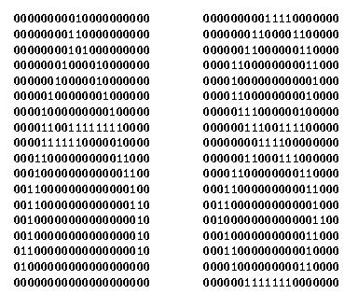
Feature Vector Representation
X=[x1, x2, … , xn], each xj a real number
xj may be an object measurement
xj may be count of object parts
Example: object rep. [#holes, #strokes, moments, …]

Slide 33
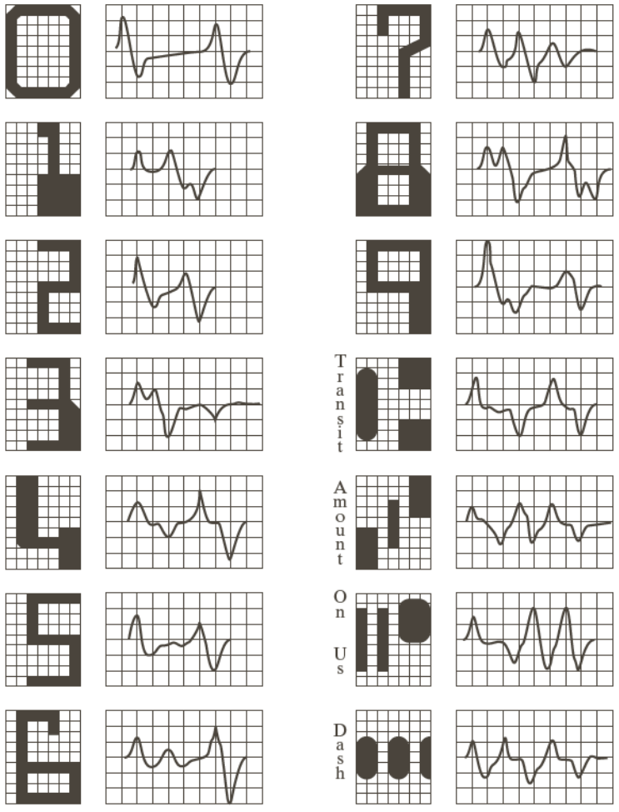
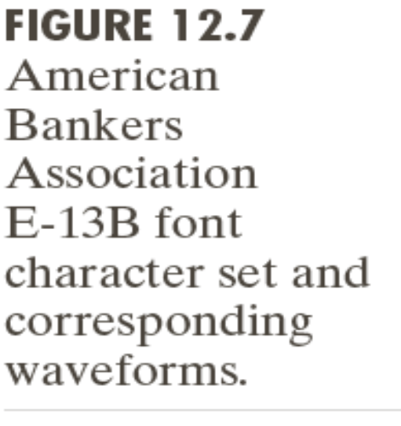
Character set

Slide 34
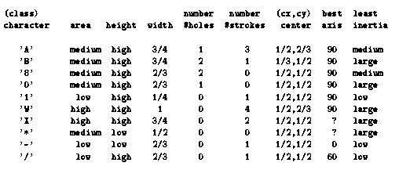
Possible features for character recognition

Slide 35
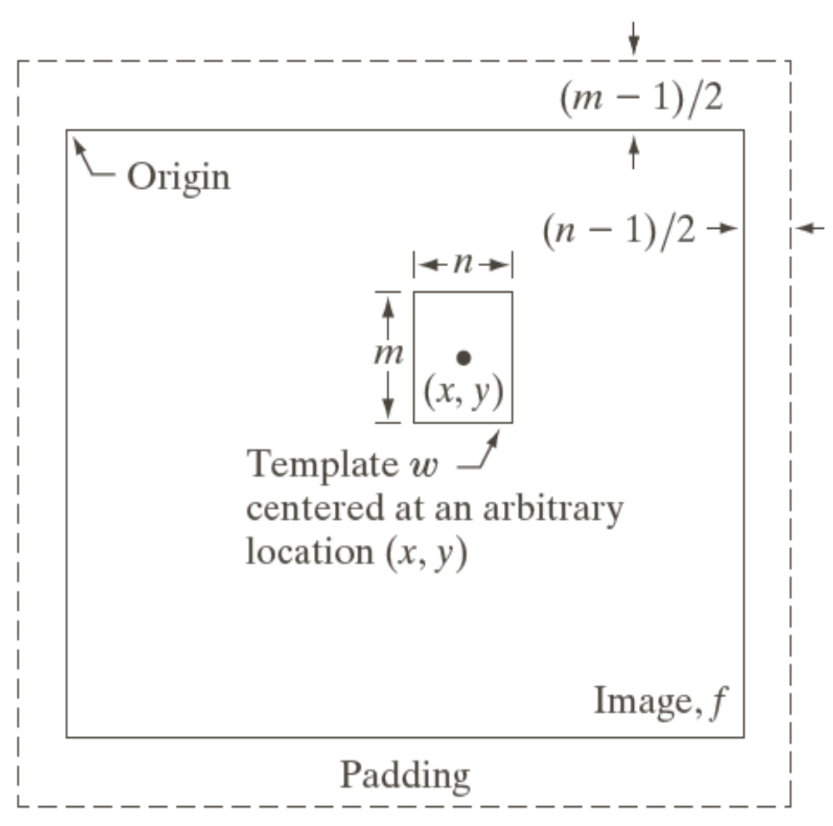
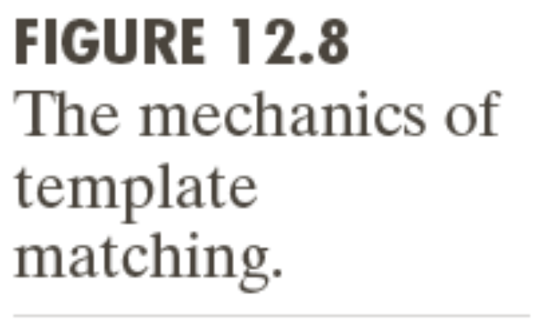
Template matching

Slide 36
Few terminology
Classes: set of m known categories of objects
(a) might have a known description for each
(b) might have a set of samples for each
Reject Class:
a generic class for objects not in any of
the designated known classes
Classifier:
Assigns object to a class based on features

Slide 37
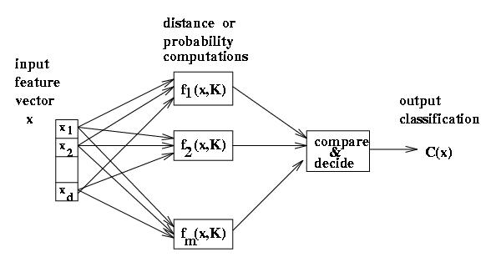
Discriminant functions
Functions f(x, K) perform some computation on feature vector x
Knowledge K from training or programming is used
Final stage determines class

Slide 38
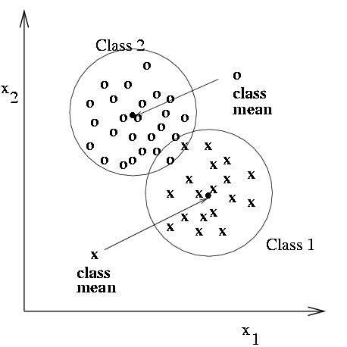
Classification using nearest class mean
Compute the Euclidean distance between feature vector X and the mean of each class.
Choose closest class, if close enough (reject otherwise)

Slide 39
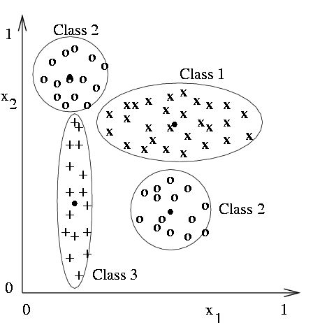
Nearest mean might yield poor results with complex structure
Class 2 has two modes; where is its mean.
But if modes are detected, two subclass mean vectors can be used

Slide 40
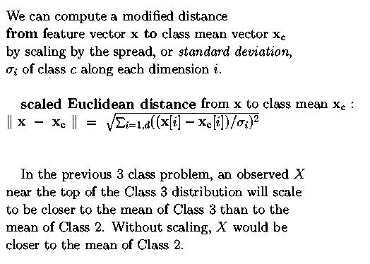
Scaling coordinates by std dev

Slide 41
Nearest Neighbor Classification
Keep all the training samples in some efficient look-up structure.
Find the nearest neighbor of the feature vector to be classified and assign the class of the neighbor.
Can be extended to K nearest neighbors.

Slide 42
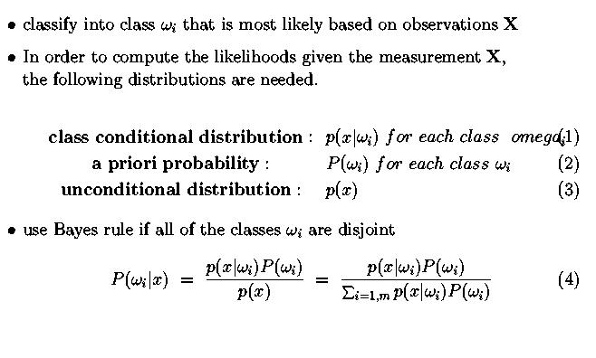
Bayesian decision-making

Slide 43
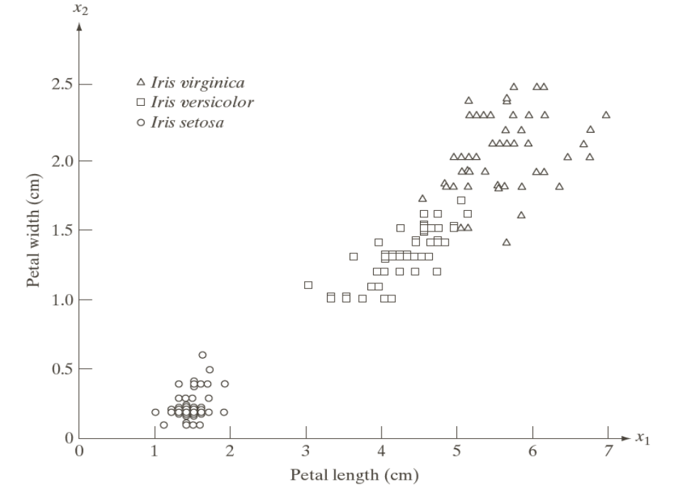
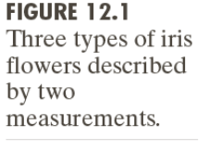
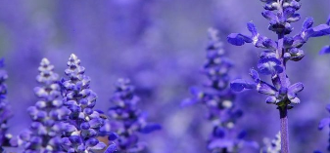
Flower classification
Iris flower dataset

Slide 44
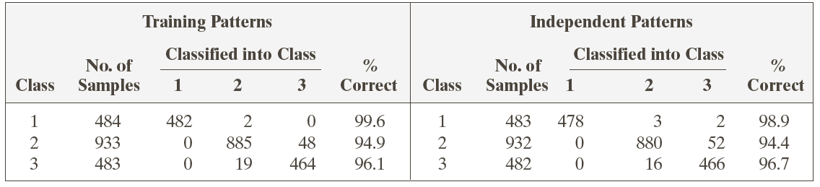
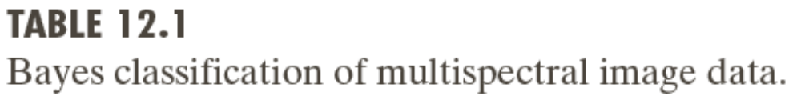
Bayes classification of multispectral image data

Slide 45
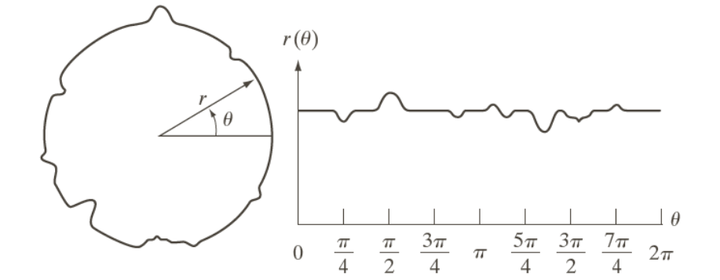
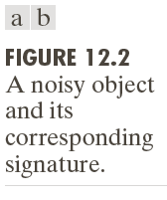
Noisy object

Slide 46
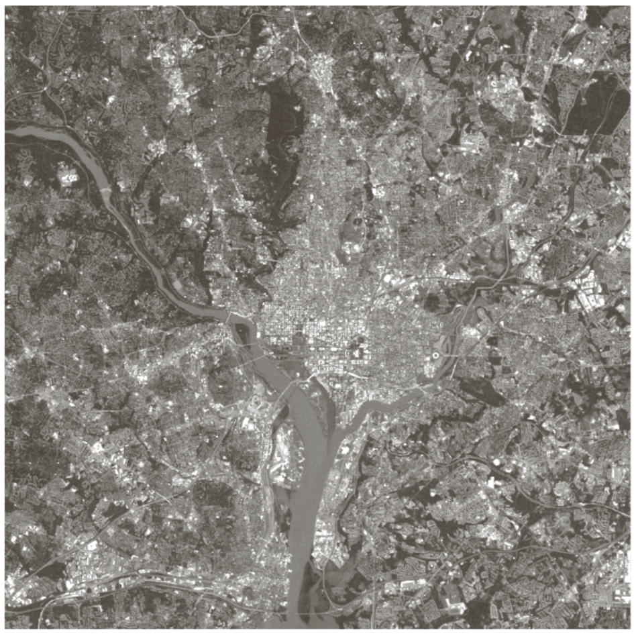
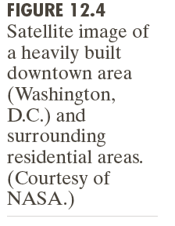
Noisy object

Slide 47
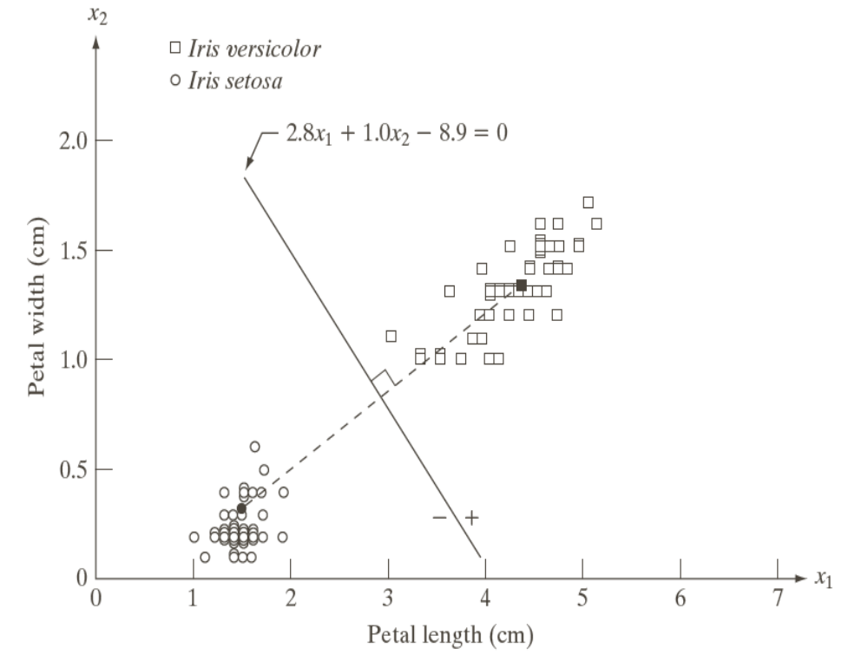
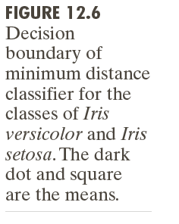
Flower classification

Slide 48
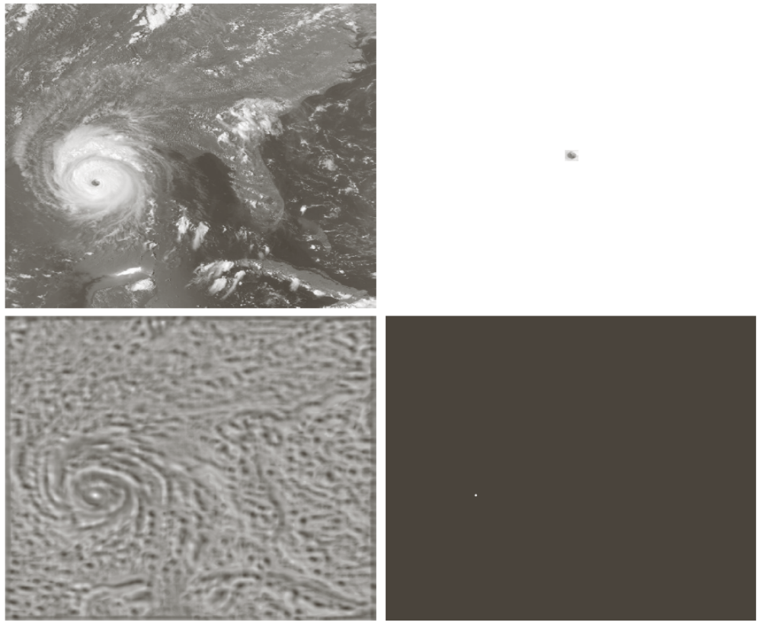
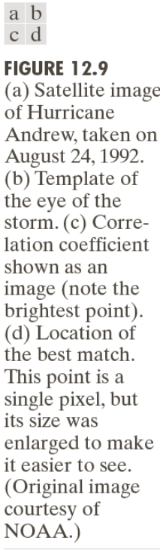
Object recognition

Slide 49

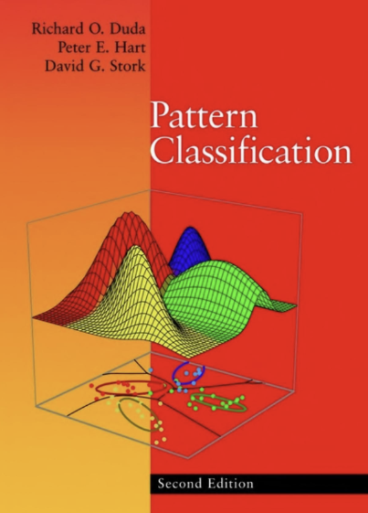
Reference
Chapter 12 Feature extraction
Pattern Classification (chapter1) by R. O. Duda, P. E. Hart and D. G. Stork, John Wiley & Sons, 2000

Slide 50

Question

Slide 51

Thank you

